Slide 1


Good spot for Levantine cuisine restaurant in Paris
Roger Rahme

Slide 2
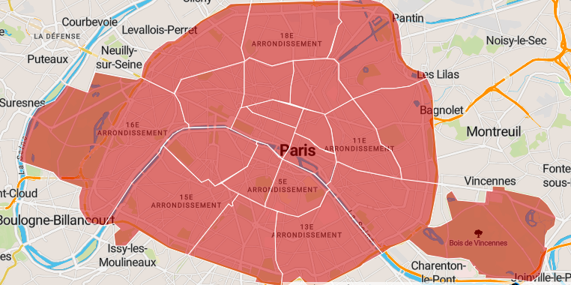


Paris is divided into 20 Arrondissements (Rounds). I got the detail of these Arrondissements from the following link: https://opendata.paris.fr/explore/dataset/arrondissements/table/

Slide 3
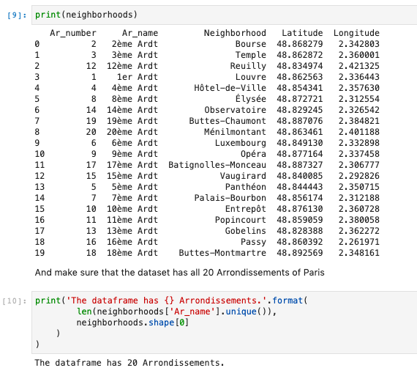
We first download the data, clean it And make sure that the dataset has all 20 Arrondissements of Paris

Slide 4
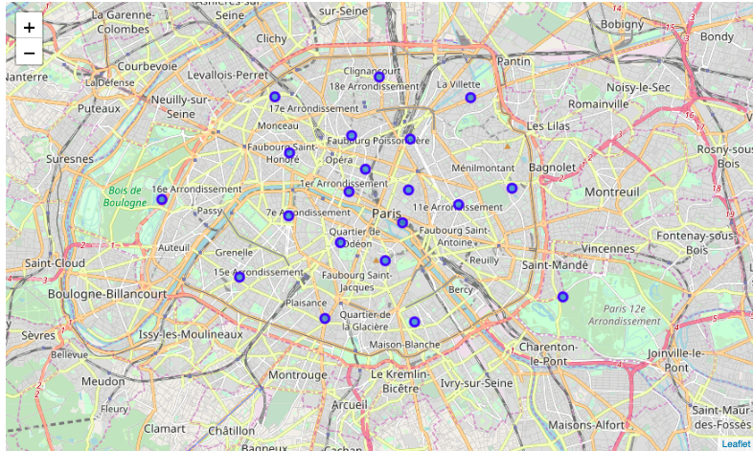
Show the 20 Arrondissements of Paris on the MAP

Slide 5
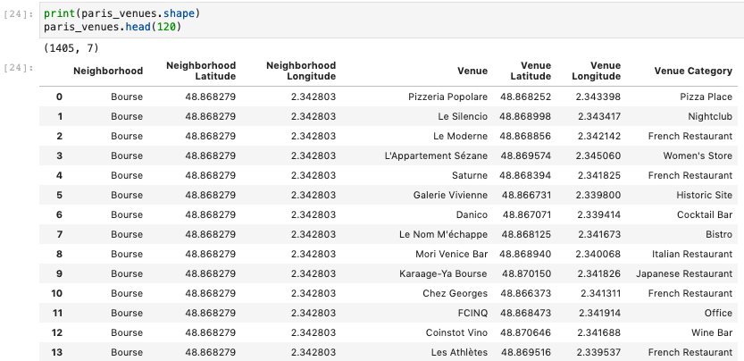
We start to explore all the Neighborhoods of Paris to get up to 100 Venues per Arrondissement. We get up to 1,405 Venues in PAris

Slide 6
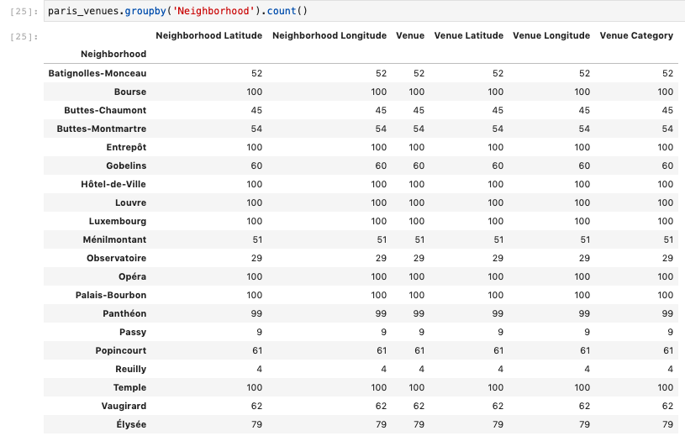
Then we group the returned venues to show the number number restaurants per Arrondissement

Slide 7
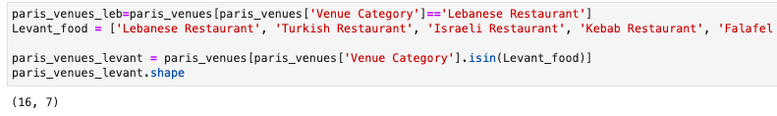
In order to list Levantine cuisines, we need to filter the following restaurants returned by foursquare: Lebanese, Turkish, Israeli, Kebab & Falafel

Slide 8
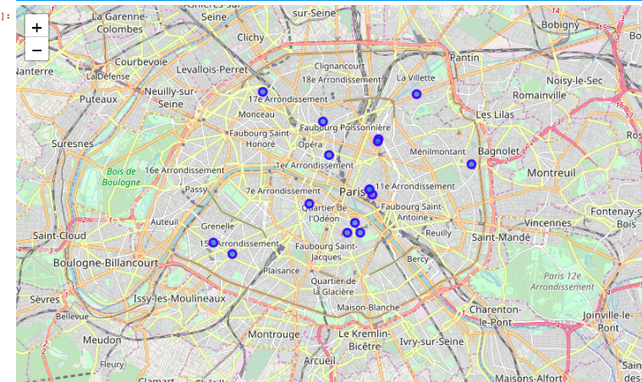
We display the Levantine restaurants in Paris to see how they are scattered and which Areas are not close to any of the existing restaurants

Slide 9
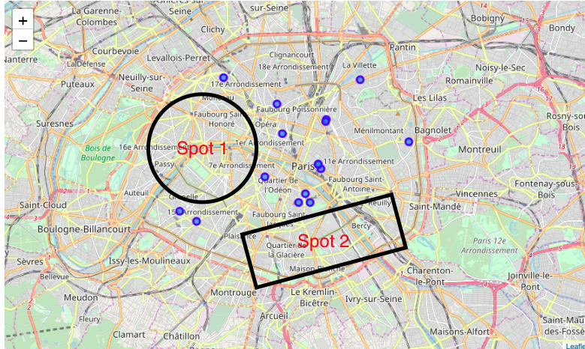
From the map we can see that there are 2 good spots: - Spot 1: 12eme, 13eme & 14eme Arrondissements - Spot 2: 7eme, 8eme, 15eme,16eme & 17Eme Arrondissements Opening a Levant food restaurant in any of the 2 Spots would have a good advantage as there's no competition for this particular cuisine

